Slide 1
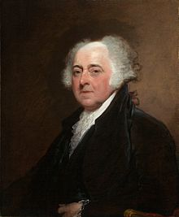
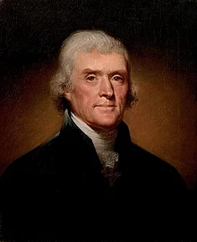
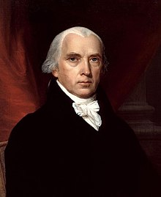
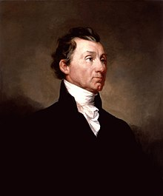
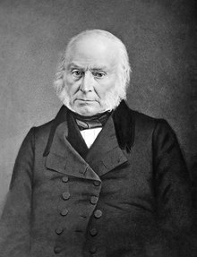
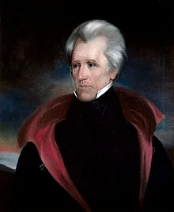
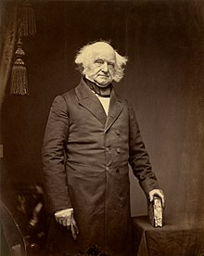
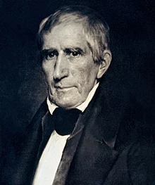
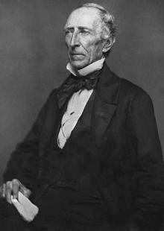
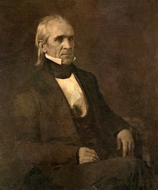
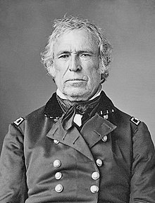
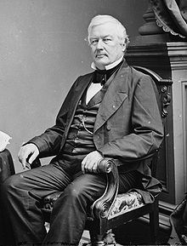
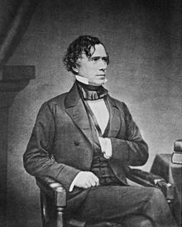
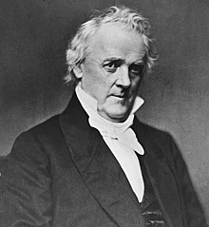
Adams-Buchanan
Adams –Buchanan

Slide 2
XYZ Affair
President: John Adams
France is mad
They helped us win our revolution, we don’t help them with theirs
To make matters worse the Jay Treaty is beginning to repair our relationship with England (France’s sworn enemy)
Notes:

Slide 3
XYZ Affair
The US sends 3 diplomats to France to negotiate a solution so we can avoid war
Before the official meetings begin France demands bribes and a loan
Offended, 2 US diplomats head for home before the meetings start

Slide 4
XYZ Affair
Result: The Quasi- War
A Naval War fought between the US and France
Most of it is fought in the Caribbean
It ends at the Convention of 1800 when we negotiate with France’s new leader, Napoleon

Slide 5
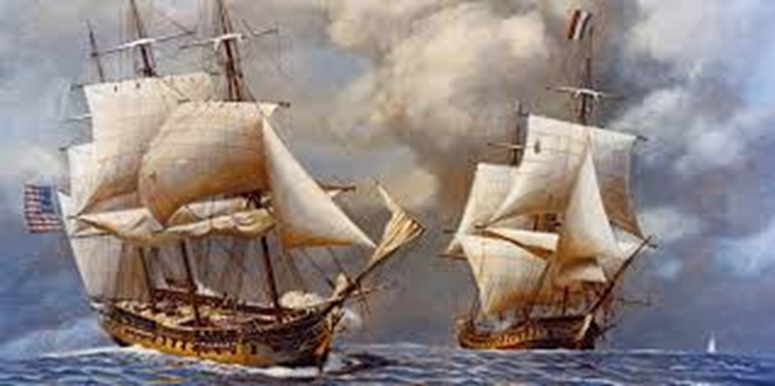
XYZ Affair
The Federalists
The Democrat-Republicans
We should build an Army in case we have to fight France
We should help France fight their Revolution, after all they helped us

Slide 6
Louisiana Purchase Lewis & Clark Expedition
President: Thomas Jefferson
Notes:
In 1803 Napoleon needs money to fund his wars
He sells 828,000 square miles of land to the US for 15 million dollars (It comes out to about $18 a mile!)
President Thomas Jefferson commissions Meriweather Lewis and William Clark of the US Army to form a Volunteer Corps to check out the land we bought

Slide 7
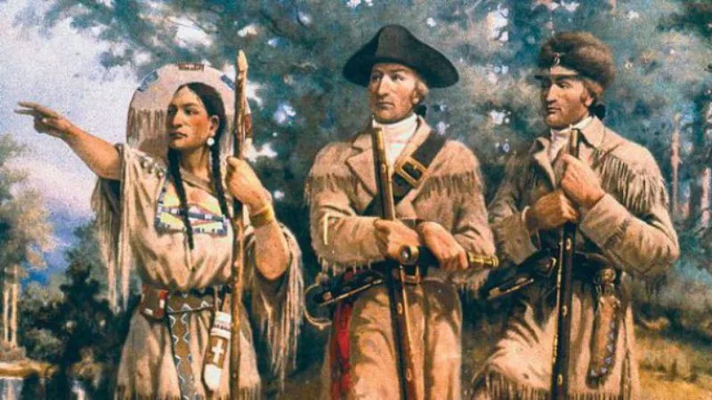
Lewis and Clark
They are gone for 2 years and 4 months
Their job is to make maps and write journals showing: geography, trade routes, plants, animals, and Native American Tribes

Slide 8
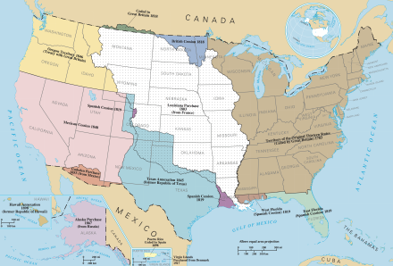

Slide 9
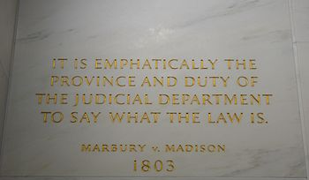
Marbury v. Madison
President: Thomas Jefferson
Notes:
1803
The U.S. Supreme Court cases that established Judicial Review
American courts have the power to strike down laws, statutes, and some government actions that violate the U.S. Constitution.

Slide 10
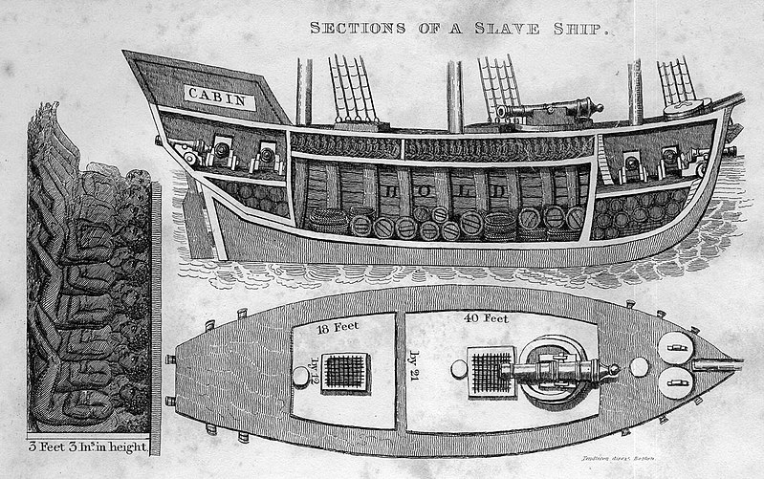
Law Banning the Importation of Slaves
President: Thomas Jefferson
Notes:
1808 Federal law prohibits new slaves from being brought into the United States from foreign countries

Slide 11
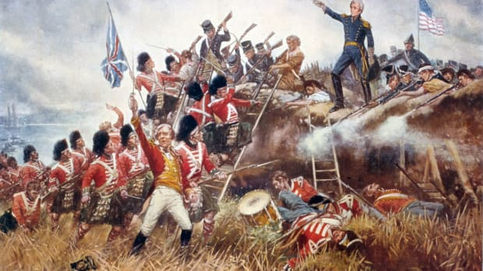
War of 1812
President: James Madison
Notes:
June18, 1812-February 17, 1815
War between U.S. and England

Slide 12
War of 1812
England keeps capturing our ships and forcing our sailors to join their Navy
President Madison gets pressured by war hawks to go to war
England sends money and guns to Native American tribes who are still fighting the U.S. government

Slide 13
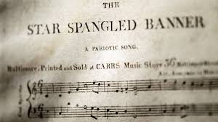
War of 1812
We fight along the frontier
We try to invade Canada several times, but we don’t get any more land
Frances Scott Key writes the Star Spangled Banner

Slide 14
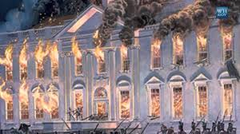
The Burning of the White House
Notes:
The British burn Washington, D.C.
James Madison and members of his government flee to Brookesville, Maryland
James Madison writes a letter to his wife, Dolly Madison, telling her to be prepared to leave at a moments notice

Slide 15
The Burning of the White House
Dolly organizes slaves and staff to save the valuables in the white house including the famous portrait of George Washington
The White House is reconstructed from 1815-1817

Slide 16
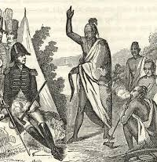
Creek Wars
President: James Madison
Notes:
1813-1814
War between the U.S. Army and the Creek Native Americans
General Andrew Jackson forces the Creek Tribe to surrender 21 million acres in Georgia and Alabama

Slide 17
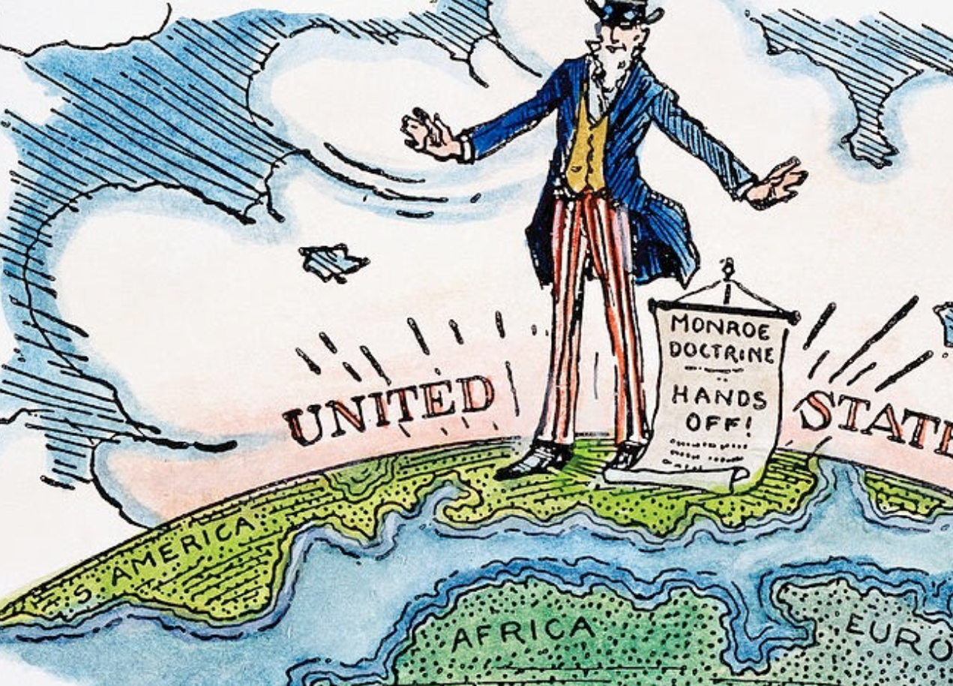
Monroe Doctrine
President: James Monroe
Notes:
Written by John Quincy Adams
President James Monroe gives the speech Dec. 2, 1823 during his 7th State of the Union Address
Defining Moment in foreign policy

Slide 18
Monroe Doctrine
2 key points
The New World is no longer subject to colonization by European countries
The U.S. will remain neutral on existing colonies in the Americas, but we will not allow European powers to create new colonies in North America, Central America, or South America

